Slide 1


A Food Recommendation System
Domain : - Real world applications in Data Science

Slide 2
TEAM MEMBERS
Akhilesh Damke 08
Satej Kulkarni 07
Shubha Desai 06
Samruddhi Kale 05

Slide 3
PROBLEM STATEMENT
To design and develop a food recommendation system that suggests personalized food options to users based on their preferences, past interactions, and dietary restrictions.
The goal is to enhance the user experience by suggesting dishes that they are most likely to enjoy and cater to their dietary needs

Slide 4
INTRODUCTION
The Food Recommendation System provides users with personalized food recommendations
Easier for users to discover new foods
It is based on machine learning algorithms
Provides a user-friendly interface

Slide 5
Existing food recommendation systems
YELP
OPEN TABLE
It provides personalized recommendations based on their reviews
EXISTING SYSTEMS
This is a restaurant reservation that also provides recommendations for nearby restaurants
HELLO FRESH
ALLRECPIES
This is a recipe discovery and sharing website that provides personalized recipe recommendations
This is a meal kit delivery service that provides personalized recipe recommendations

Slide 6
OBJECTIVES
To provide personalized food recommendations to users based on their preferences & dietary restrictions
To make the process of finding new and interesting food options easier for users.
To promote lesser-known or underappreciated dishes and cuisines.
To provide an engaging user experience through a GUI.
To continuously improve the accuracy of the recommendation algorithm through user feedback and machine learning techniques

Slide 7
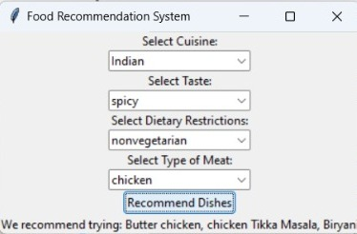
PROPOSED WORK
The Food Recommendation System provides users with personalized food recommendations which is based on based on machine learning algorithms
ML algorithms used:- Collaborative filtering , Content-Based Filtering

Slide 8
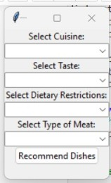
GUI INTERFACE

Slide 9
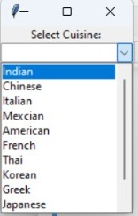
CUISINE SELECTION

Slide 10
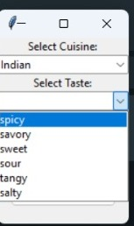
TASTE CHOICING

Slide 11
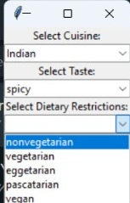
DIETARY RESTRCITIONS

Slide 12
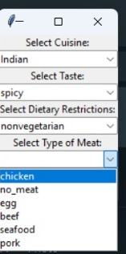
SELECT TYPE OF MEAT

Slide 13
GET RECOMMADATION

Slide 14
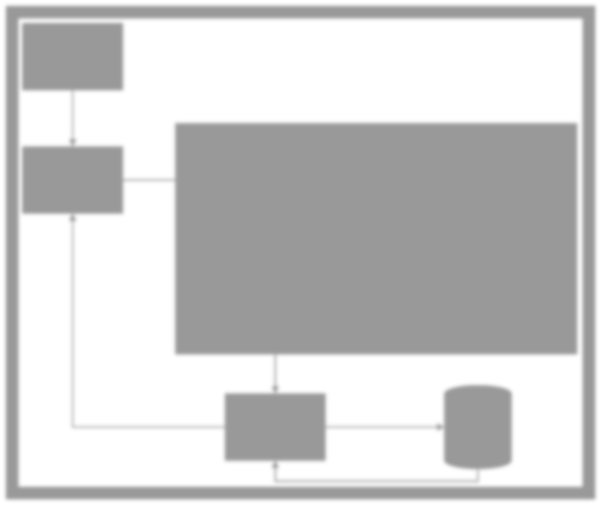
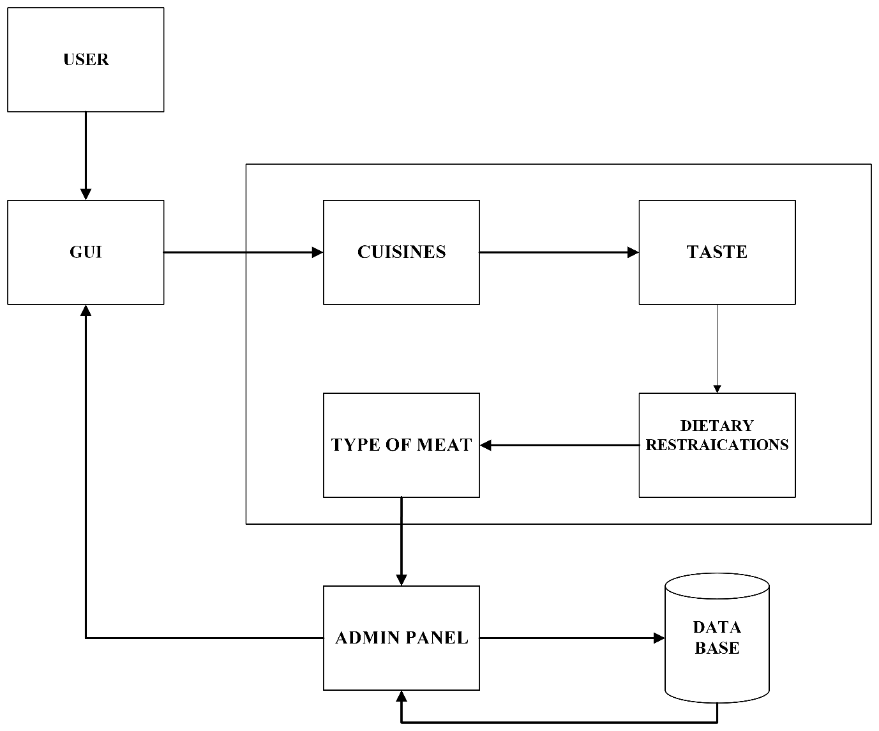
SYSTEM ARCHITECTURE

Slide 15
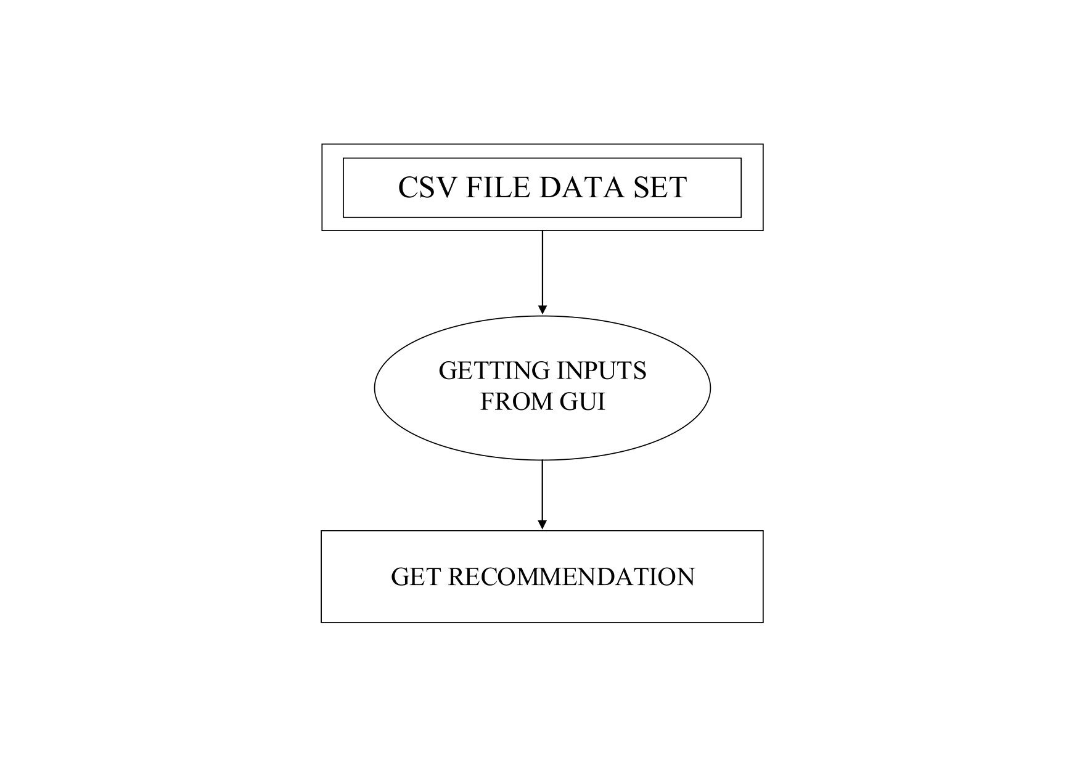
DFD LEVEL 0

Slide 16
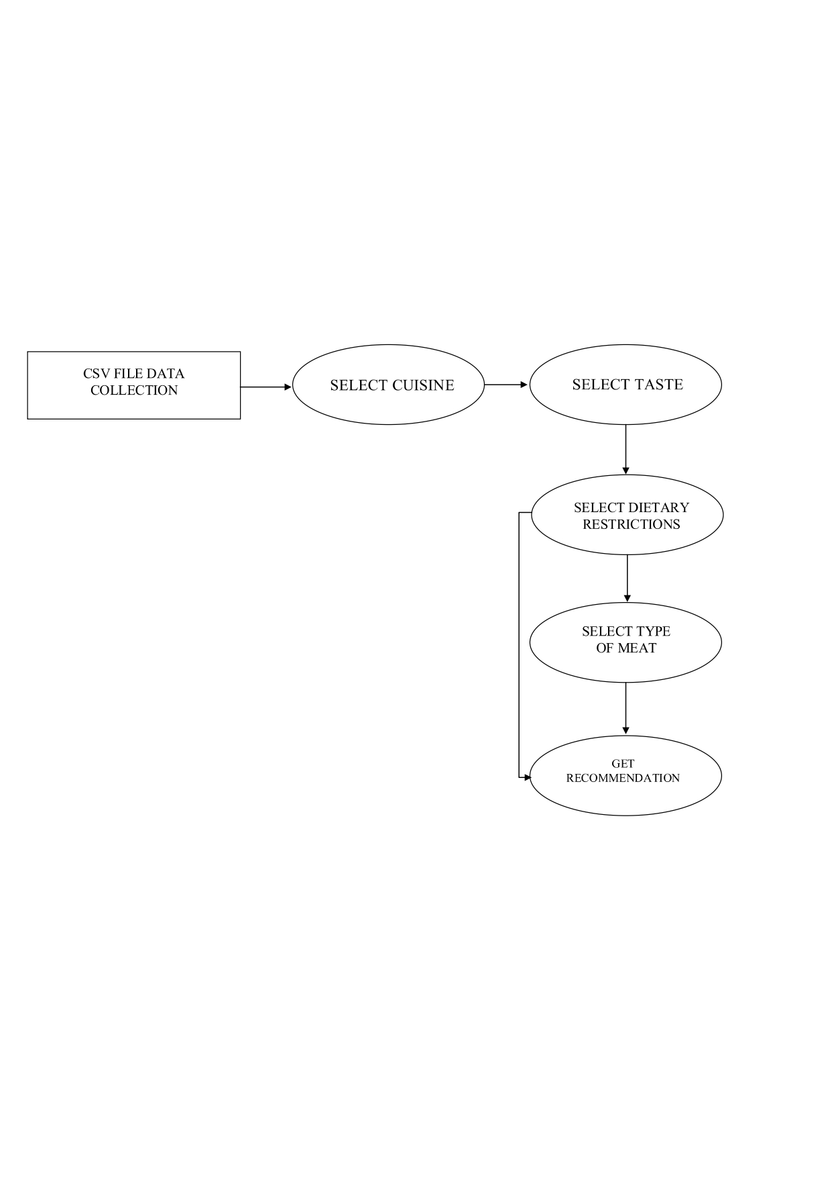
DFD LEVEL 1

Slide 17
ADVANTAGES
Personalized recommendations
Improved user experience
Better decision-making
Increased engagement

Slide 18
LIMITATIONS
Limited data
Over-reliance on the system
Lack of understanding of the recommended dishes

Slide 19
HARDWARE REQUIREMENTS
Processor
RAM
Storage
Broadband
Intel Pentium or higher
4 GB or more
256 GB or more
With good speed

Slide 20
SOFTWARE REQUIREMENTS
IDE
DATABASE
WampServer
Excel
Anaconda Jupiter notebook

Slide 21
FUTURE ENHANCEMENTS
Integration of food delivery services
Integration of health data
Integration of restaurant reviews
Enhanced data analytics
Gamification
Integration of augmented reality

Slide 22
CONCLUSION
Food recommendation system is a valuable tool for individuals who are looking to discover new and exciting Cuisines
The system also has the potential to help individuals make healthier and more sustainable food choices.
This project can be a great learning experience for beginners interested in data science and machine learning.
We gained experience in data cleaning & preprocessing, exploratory data analysis, and building machine learning models.

Slide 23
REFRENCES
Kaur, P., & Bhatia, S. (2019). Food recommendation system: A systematic review. Journal of Ambient Intelligence and Humanized Computing, 10(1), 251-270.
Liu, Y., Wu, S., & Wei, X. (2018). A food recommendation system based on the integration of user preferences and nutritional values. Food & Nutrition Research, 62.
Wang, H., Li, J., Li, Q., Zhao, L., & Li, R. (2019). A food recommendation system based on user preference mining and LDA algorithm. IEEE Access, 7, 33379-33387.
https://www.kaggle.com/c/whats-cooking-kernels-only/overview
https://www.datacamp.com/community/tutorials/recommender-systems- python
https://towardsdatascience.com/how-to-build-a-simple-recommender- system-in-python-375093c3fb7d

